Slide 1

Cyber Secuirty Careers
.

Slide 2
TABLE OF CONTENTS
01
02
03
Variety of Jobs
Market Trends
Certifications
04
05
06
Experience Level
Listings
Comparing markets
07
08
09
Market Share
Company Size / remote Jobs
Roadmap

Slide 3
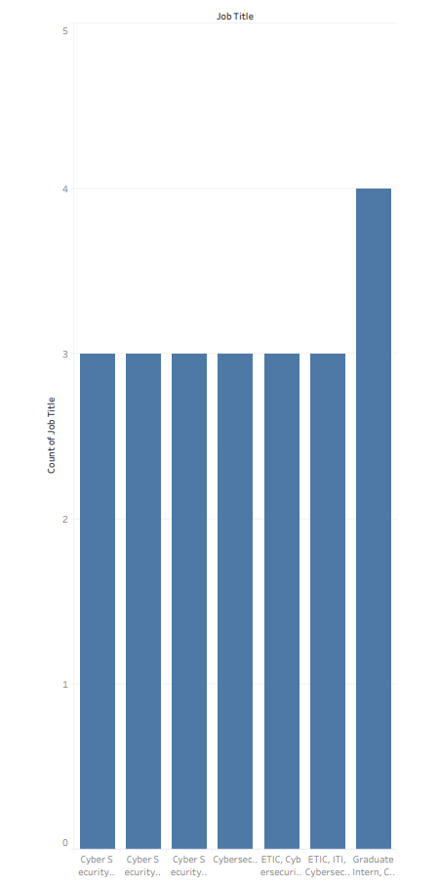
Variety of Jobs
Graduate Intern, Cybersecurity Engineer
Cybersecurity IAM/IDAM
Cybersecurity Threat Detection and response
Cybersecurity FOSS Analyst
Cybersecurity SOC Engineer
Cybersecurity Intern (Remote)
Cybersecurity Engineer

Slide 4
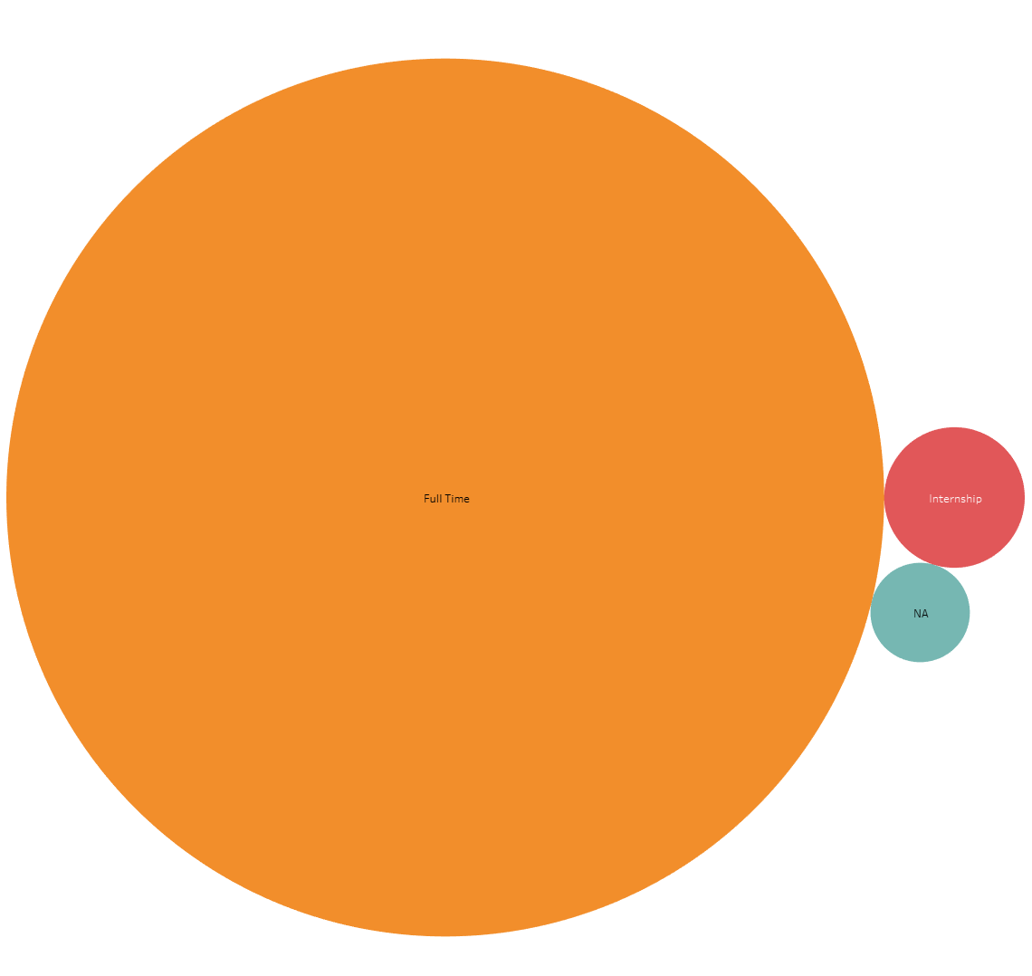
MARKET TRENDS
Full Time: 96%
130 hours
Internship: 2.5%
80 hours
NA: 1.5%
Not specified

Slide 5
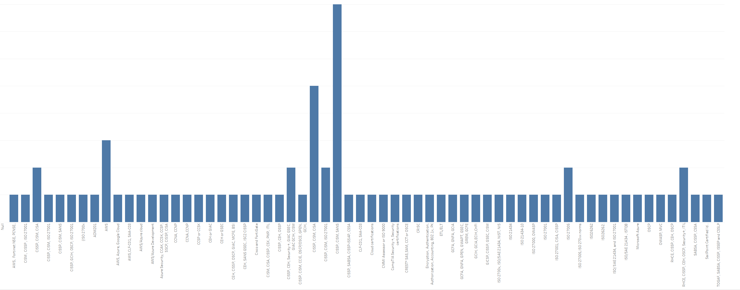
Certifications
1. CISSP,CISM,SANS
2. CISSP,CISM,CISA
3. AWS

Slide 6
Certifications
CISSP
CISM
Certified Information Security Manager
Certified Information System Security professional
SANS
CISA
SysAdmin Audit Network and Security
Certified Information Systems Auditor
Notes:
CISSP covers the fundamental elements of the entire cybersecurity field
CISM is an advanced certification that indicates that an individual possesses the knowledge and experience required to develop and manage an enterprise information security program
SANS covers the fundamentals and technical aspects of information security
CISA is the global standard for professionals who have a career in information systems, in particular, auditing, control, and security

Slide 7
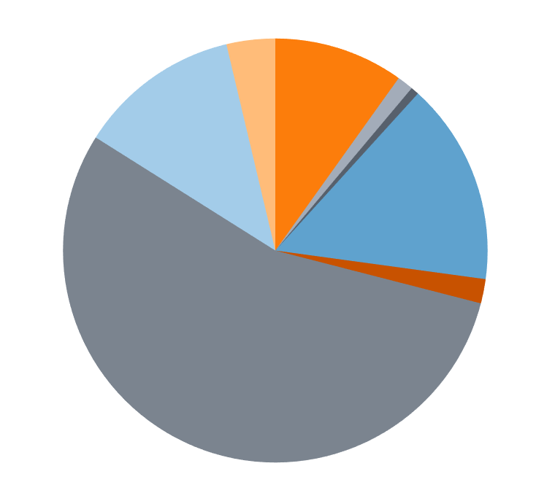
Experience Level
Mid Senior
5-8 years of experience
Entry
0-5 years of experience
Associate
2-3 years of experience

Slide 8
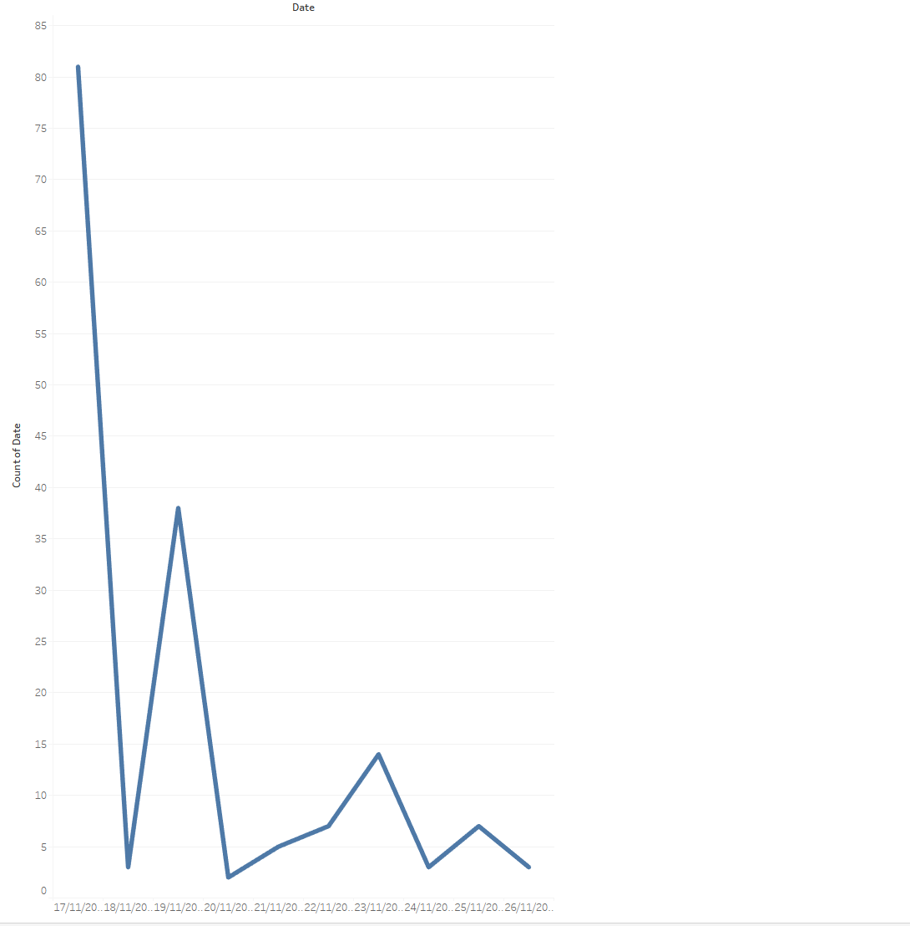

Listings
81 Jobs
38 Jobs
2 Jobs
14 Jobs
7 Jobs
3 Jobs
5 Jobs
3 Jobs
3 Jobs

Slide 9
Market Comparison
370
Jobs Germany
30
Jobs Egypt

Slide 10
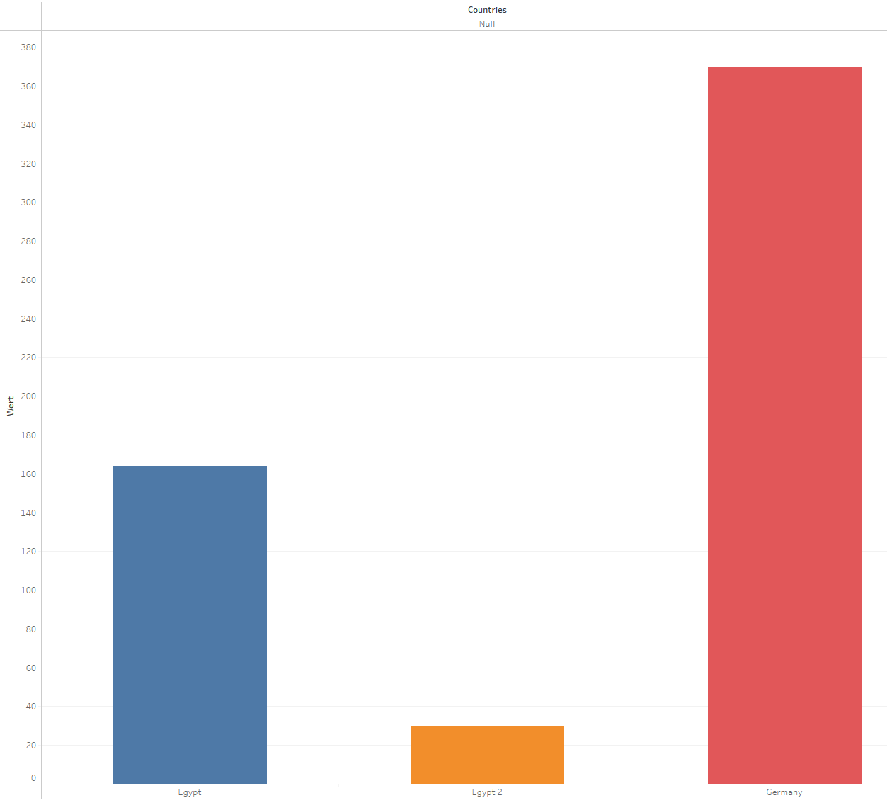
370 Jobs
Germany
164 Jobs
Egypt (Combined)
30 Jobs
Egypt (Glassdoor)

Slide 11
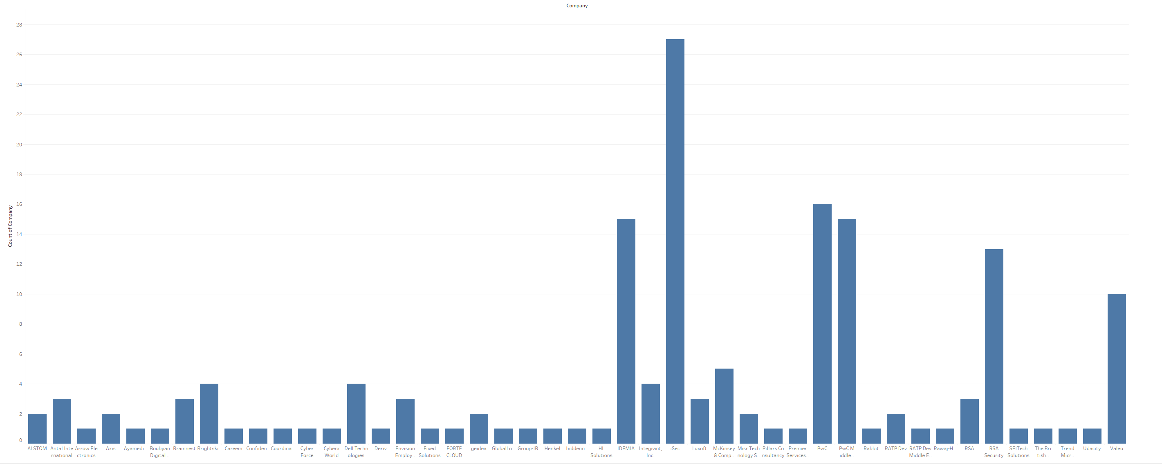
MARKET SHARE
PwC
iSec
IDEMIA

Slide 12
Company Sizes
RANGE | AVG | TOTAL COMPANIES
50-10000 | 5800 | 150

Slide 13
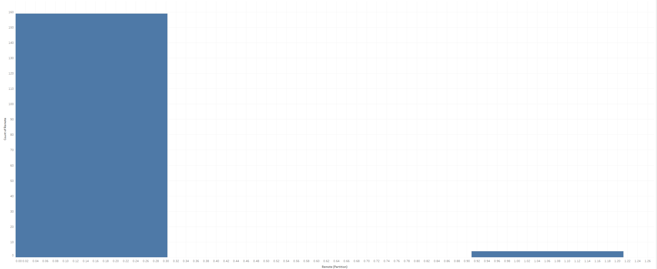
Remote jobs
160 On site
4 Remote

Slide 14
Roadmap
Masters
Internship
Two Years
Two Years
Entry level
Intermediate
1 year
.

Slide 15

?
Problems with the job market

Slide 16

END

